Slide 1
Course Description
ONLINE
By GamingWorks
Version 1.0 UK

Slide 2
Why this simulation?
Organizations are changing fast. Digital Transformation, corporate agility,Lean, DevOps, Scrum are words that are commonly used in IT Development teams. IT Operations must follow and adopt these new ways of working and transfer them into fast delivery of new reliable services.
Teams are working increasingly as remote teams, they need to learn how to collaborate, how to communicate and how to manage the work.
Teams will use new technology to support remote work. Visualization and collaboration tools.

Slide 3
About this simulation
Delegates will work as an IT Team to support this mission to Mars
The Product Owner will bring in new service requests and customer feedback from universities, high schools, research centers and customers from all over the world.
While Flight Operations manages the flight and will discover risky issues during this flight that must be solved.
IT has many bottlenecks and cannot deliver all services as agreed.
The Service Manager has a list of great Service Improvements to solve some serious issues.
Can you manage to apply ITIL4 principles and make the right decisons to make this mission a success?

Slide 4
Objectives of this simulation
Explore and experience how ITIL4, Agile, Lean and DevOps ways of working can help improve the delivery of services.
Experience the consequences for your own organization and team.
Experience the use of tools to work remotely.
Experience effective collaboration and communication in remote teams.

Slide 5
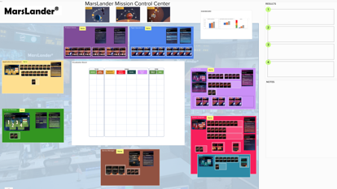
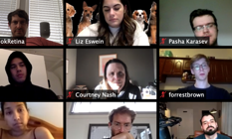
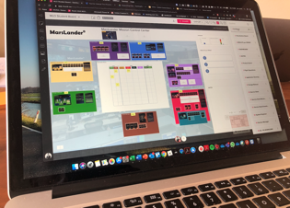
Setting of this simulation
Schermafbeelding 2020-04-17 om 09.32.29
7 participants
Using a on-line communication & collaboration tools
Sharing a digital learning environment
3 rounds
Playing time 5 hours
2 modules of 2,5 hours or
3 modules of 2 hours

Slide 6
Target Audience
IT Operations employees to learn how to make their work more Agile and Lean, and how to apply ITIL4 in a realistic environment.
IT Management to learn the essence of ITIL4 and how to facilitate/support remote working.
Non-IT teams to create overall ITIL4 awareness.

Slide 7
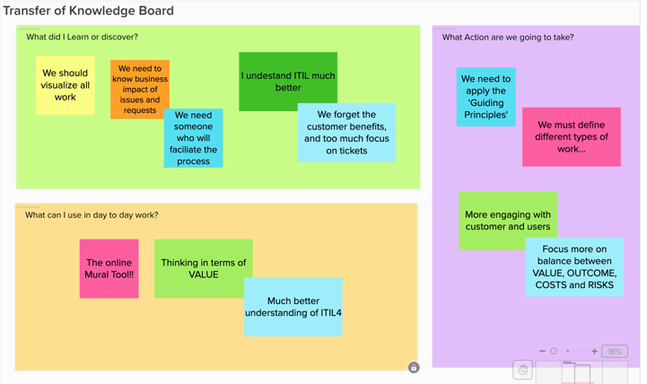
Lessons Learned

Slide 8
Feedback
“Impressed by the fast learning curve. We started a bit messy, we ended and a mature team!”
“In this session I start to understand ITIL4 much better”
“Very exciting experience, lot’s of great learning and gave me we a lot of energy”
“Did not know that we are using so many ‘Guiding Principles’ in our daily work”
“Great way to learn how to develop remote working teams. Fun and energetic”

Slide 9
Requirements
Students are using the Mural collaboration tool to plan and execute the work.
Students will use any communication tool to discuss, reflect and work together.
There is no specific knowledge needed on ITIL4 to experience this simulation.
Since this learning environment is new for many of the students, we strongly advice each of the students to prepare for this session by following the ‘Introduction Exercises’. This is a 30 minutes movie plus some exercises to learn about Mural and how the simulation works. This will help the team to start the simulation quicker.
© GamingWorks

Slide 10
ONLINE
Let’ start the mission to Mars!
www.gamingworks.nl

